Slide 1

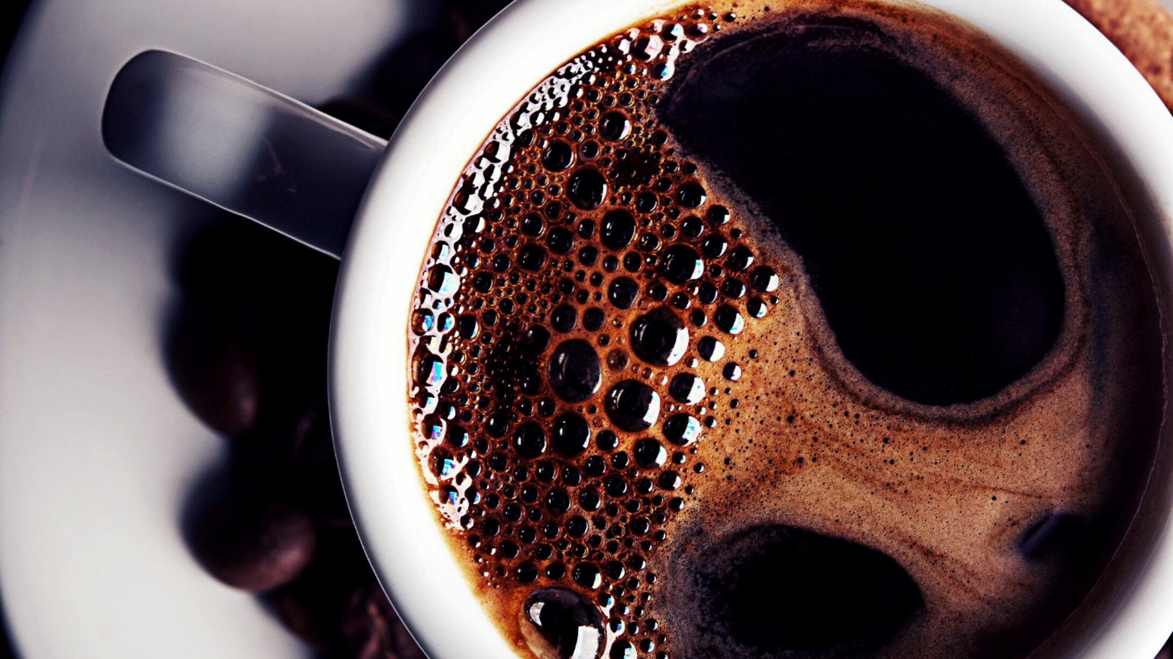
How the events of 1917-1921 in Russia affected world history through this day
Jeff Mohn - Presenter

Slide 2
A fascinating tale in three parts
A little history to set things into perspective
01
The three Russian Revolutions:
1905 and the two from 1917 to 1921
02
The legacy:
The spread of communism and Russia today
03

Slide 3
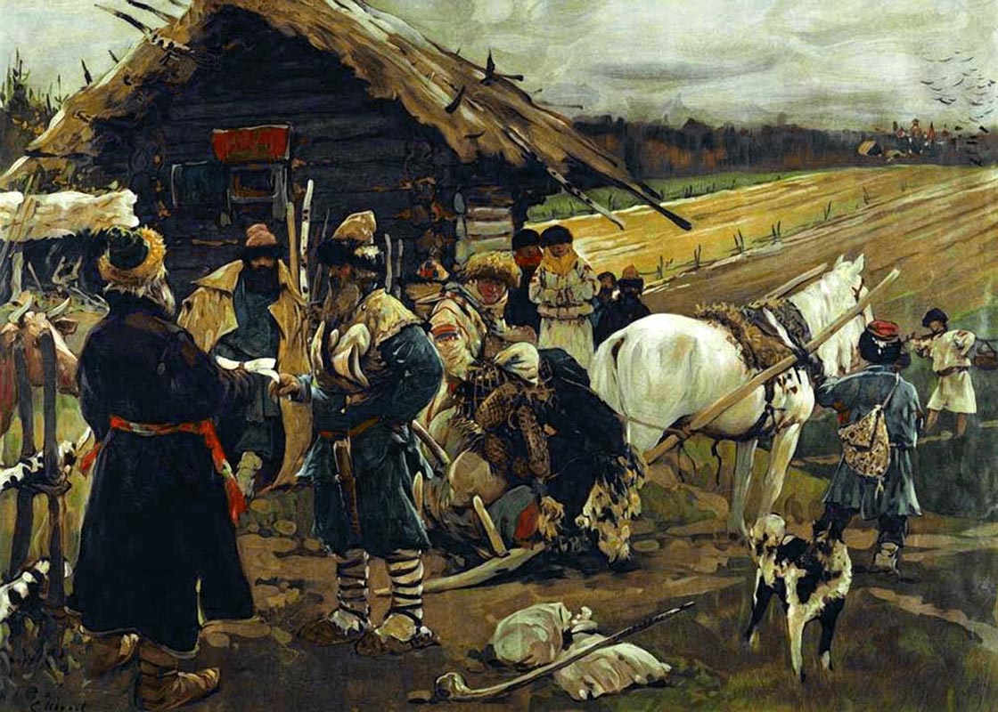
Part One – A little History

Slide 4
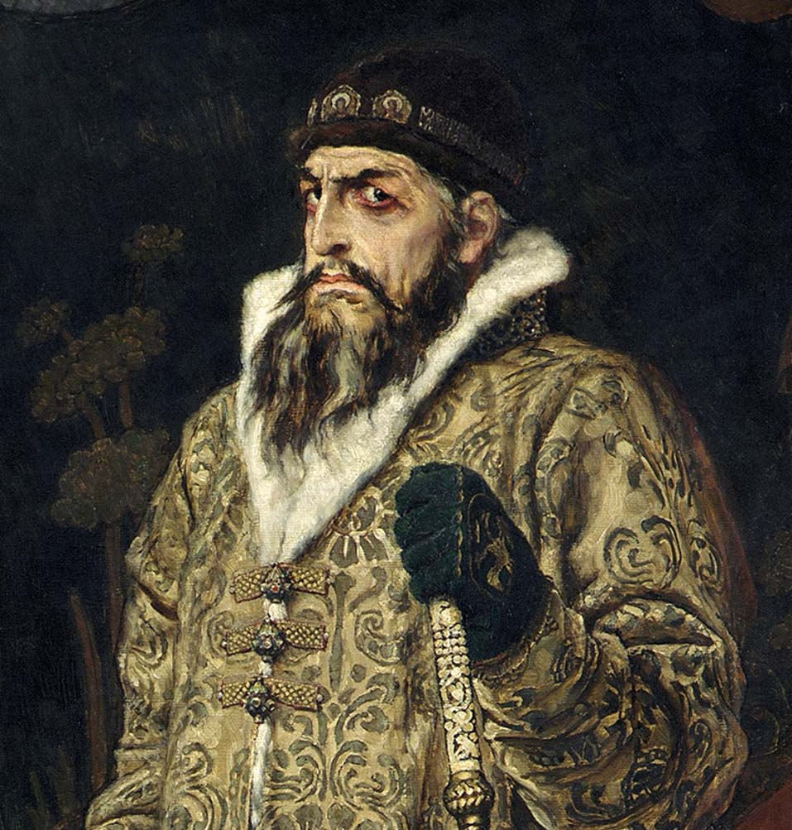
The first Tsar - Ivan the Terrible
Born on August 25, 1530 in the city of Kolomenskoye, Russia
Ivan was crowned tzar in a four hour ceremony on January 16, 1547
February 3, 1547 Ivan married Anastasia Romanova from a powerful boyar family - this family would later be known as Romanov which was the family of the last of the Russian Tzars.
The early years of his reign with a few exceptions appear to be relatively peaceful and prosperous. Ivan was a smart man who appears to have been an avid reader, a writer and art lover... and a good politician.

Slide 5
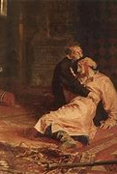
During the 1550's, the Ivan improved the organization of his central government and set up 'offices' that dealt with a single area of government. (Military, Foreign Relations, etc...) He also created a permanent military force named the Streltsy.
After his first wife's death (Anastasia), Ivan became increasingly paranoid and his policies became more stern
The next decade saw a Tsar who suspected conspiracies against him from all sides and engaged in a two decade long 'Livonian' War which was not successful and resulted in a loss of land.
He became more and more paranoid, and developed a new organization called the Oprinchina – secret police, which he used to carry out his orders – mostly to weed out and execute traitors.
His rages continued and in 1581, he beat his pregnant daughter- in-law on the excuse that her clothing was immodest. His son (also named Ivan) engaged the Tsar in an argument which ended in his (the heir's) death

Slide 6
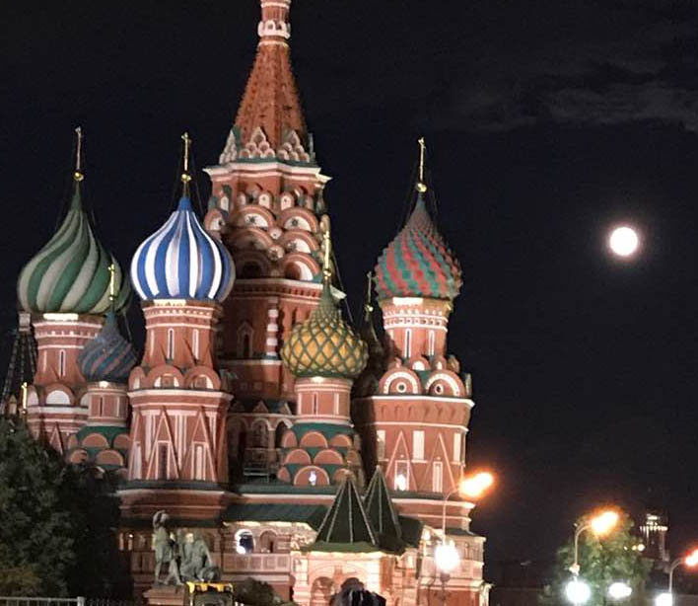
Ivan’s Legacy
Ivan built St. Basil’s Cathedral, seen here in a photo taken by me during our Russia tour.
in 1584, with his health failing, Ivan the Terrible became obsessed with death, calling upon witches and soothsayers to sustain him, but to no avail. The end came on March 18, 1584, when Ivan died of an apparent stroke. He had willed the kingdom to his unfit son, Feodor, whose rule spiraled Russia into the catastrophic Time of Troubles, leading to the establishment of the Romanov Dynasty.
When Ivan the Terrible died, he left the country in disarray, with deep political and social scars. Russia would not merge from the chaos until the reign of Peter the Great more than a century later.

Slide 7
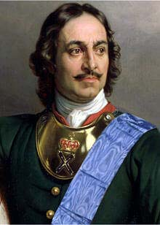
Peter the Great – 1672 to 1725
After ruling jointly with his brother Ivan V from 1682 he took over in 1696 upon his brother’s death.
At 6’8”, with a strong intellect, boundless energy and curiosity, he undertook to transform Russia into a modern state on an equal par with Western Europe.
Spent much time travelling throughout Europe to learn modern science, culture, manufacturing techniques, commerce and industry, government, shipbuilding, army and naval organization and foreign policy.
He recruited experts in science, technology and military to provide education to his people.
He also secularized schools, exercised greater control over the reactionary Orthodox Church, and reformed government administrative practices.

Slide 8
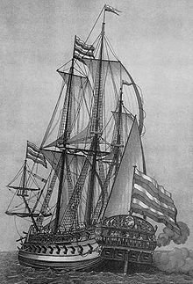
“Father of the Russian Navy”
Peter also had territorial ambitions. He wanted access to the Black Sea. In 1695 he sent ground troops and naval vessels to fight the Ottoman Empire to gain access, first to the Sea of Azov (North of the Black Sea and finally to the Black Sea itself.
He built over 1,000 warships for his fleet, but since many were made from wood that hadn’t been properly cured and dried, many ships soon became unusable.
He went to war with Sweden to acquire the territories of Estonia, Latvia and Finland to secure access to the Baltic, and its lucrative trade routes.
The battle of Poltava against Sweden in July of 1709 marked the end of Sweden’s dominance, and the beginning of Russia’s supremacy in Eastern Europe.

Slide 9
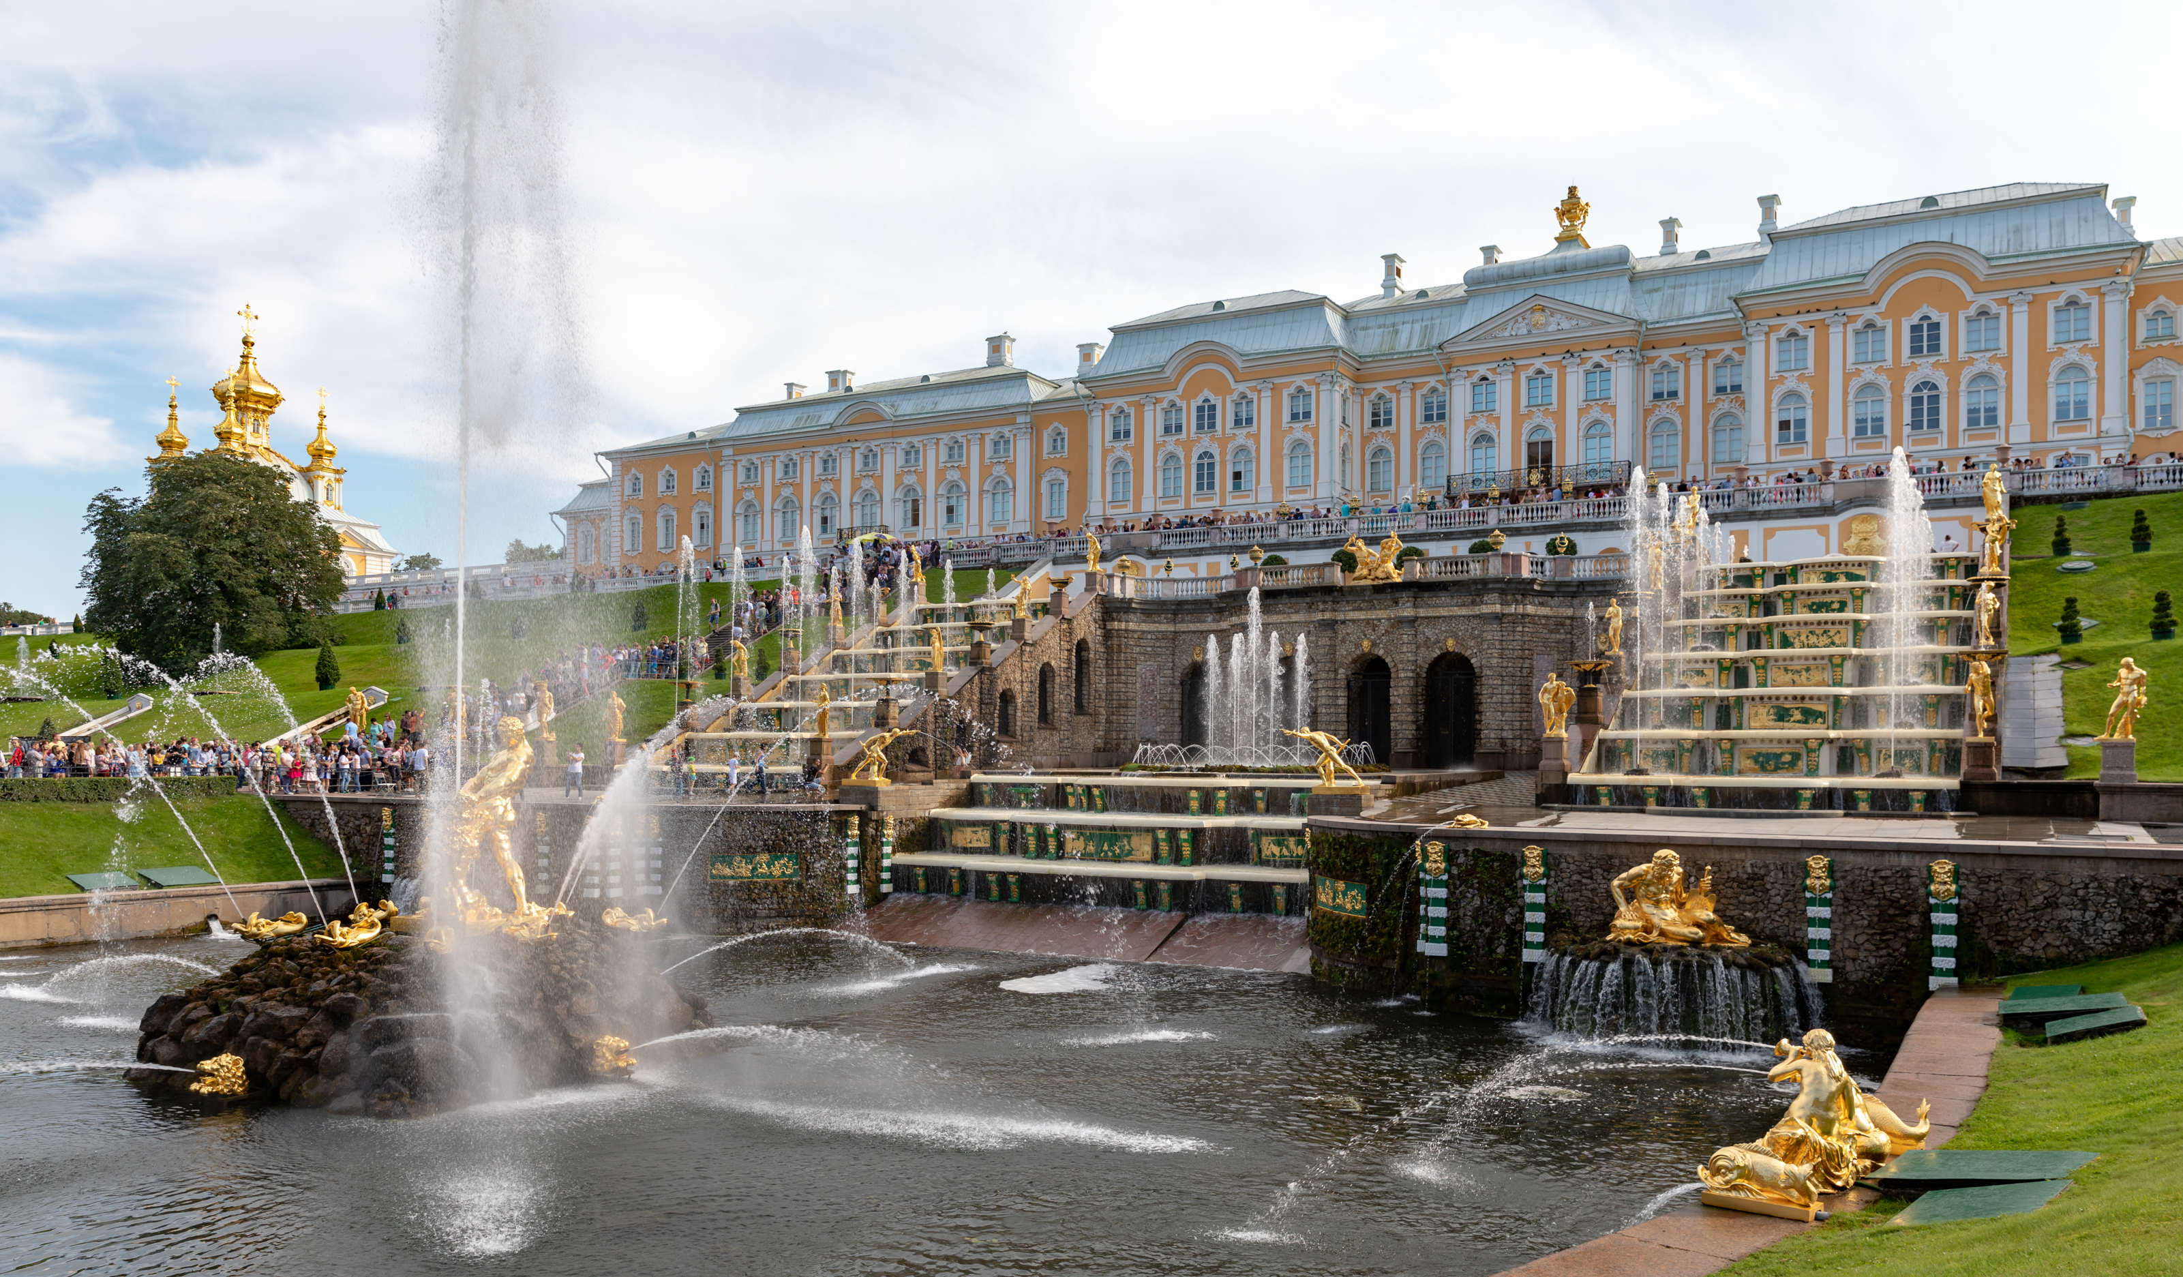
Peter’s legacy and the first seeds of Revolution
Peter made St. Petersburg the Capital of Russia. He brought in architects, engineers, skilled laborers, etc. from all over Europe and created a modern European metropolis.
The war of 1812 and the defeat of Napoleon altered the Russian psyche. Russian officers return from Paris, and in 1825 attempt a coup.
Emancipation of the Serfs in 1861 - one third of the Russian population was freed from serfdom (slavery.

Slide 10
The Winds of Change
The abolition of serfdom in Russia in 1861 was a crucial point in the country’s history and marked the first stage in its democratic transformation. Were it not for the whirlwinds of revolution that tore through Russia fifty years later the abolition of serfdom would be seen as perhaps the most significant date in Russia’s history.
Abolition gave the country’s economy a huge boost. New labor became available for industrial production and agriculture. By 1900, industrial growth was second in the world, only behind the United States.
In 1864 local government reform established elected local bodies. Women were granted the right to be employed in public and state institutions. Military reform took place. Under the old system, peasants were forced into the army for a lifetime.

Slide 11
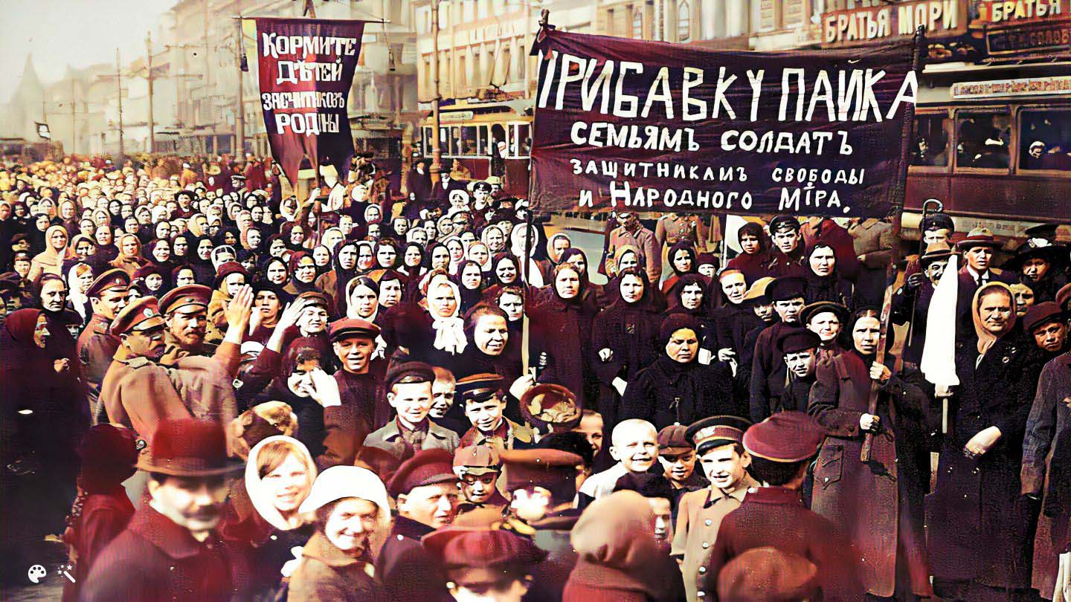
Part 2 - Revolution

Slide 12
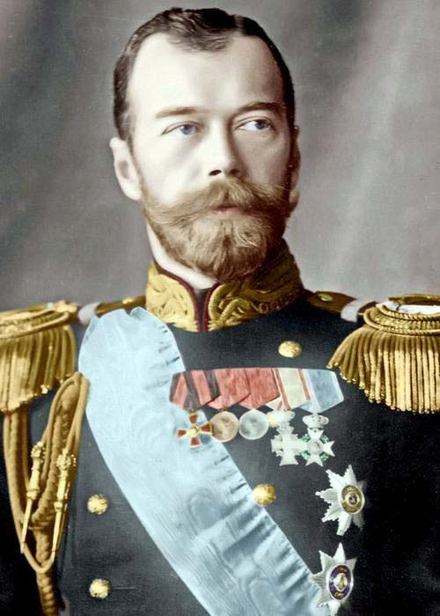
Nicholas II – 1868-1918
The last Tsar
Nikolai II Alexandrovich Romanov
Ascended the throne in 1894 upon the death of his father, Alexander III. He was a reluctant leader who was ill prepared to become Tsar. He is quoted as saying - “What is to become of me, what is to become of Russia?”
However, he strongly believed in the absolute power of the Tsar
But he made many poor decisions that eventually led to his downfall.

Slide 13
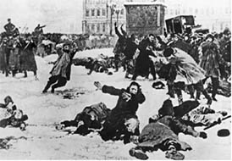
Bloody Sunday - 1905
Nicholas did not want Russia to miss out on the rise of colonialism taking place in Europe, se he decided on a land grab in Manchuria
This led to a war with Japan.
He sent his Baltic fleet to the Pacific, where it was destroyed by the Japanese fleet. He lost the war and the confidence of his subjects.
When, as a result of shortages of food and fuel, a peaceful demonstration petitioning the Tsar for radical government reforms took place in St. Petersburg, his troops fired on the crowd.
Opposition to the Tsar reached a fever pitch, and he was forced to concede reforms, and the creation of the “Duma” the Russian equivalent of a Parliament.

Slide 14
1905 to 1914
Nicholas's concessions were only limited. Changes were made in the voting laws to prevent the election of radicals and the secret police continued to crush opposition. However, the Duma did give many more people, especially the middle classes, a voice in government. But the Duma did not have real power, as Nicholas could veto any of its decisions. Its influence gradually waned prior to the 1917 revolution.
The outbreak of World War One in 1914 temporarily strengthened the monarchy, with Russia allied to France and Britain against Austria-Hungary and Germany.

Slide 15
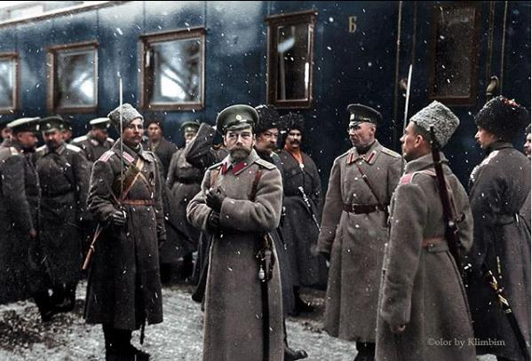
1915 “While the Cat’s Away”
The war was going badly for Russia. Casualties were horrendous, morale was very poor, troops were questioning the war and its leadership and deserting in great numbers.
Nicholas made the disastrous decision to take direct command of the Russian armies. From then on, every military failure was directly associated with him.

Slide 16
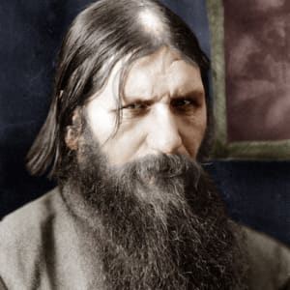
“The Mice will play”…Meanwhile, in St. Petersburg….
With Nicholas away, the Tsarina Alexandra Feodorovna took a more active role in government.
Russia was suffering heavy losses in the war, there was high inflation and severe food shortages at home, which compounded the grinding poverty most Russians already endured.
German-born Alexandra soon became the focus of discontent, as did her confidante, the mystic, Rasputin, who had been at court since 1905 and had gained great influence through his apparent ability to treat the hemophilia of Alexis, the heir to the throne

Slide 17
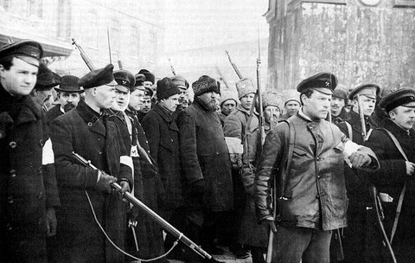
Descent into Chaos
Rasputin was assassinated on December 30, 1916 by a cadre of Russian Nobles.
By March of 1917 in the cold Russian winter, conditions in St. Petersburg had grown so terrible that people were starving, There was not enough bread and fuel. The war was getting worse and soldiers were deserting by the thousands.
On March 8th, protests (not riots) began in St. Petersburg Mostly women demanding bread.
Early on in the protests, Nicholas ordered his troops to fire on the protesters, which they did.
Soon after, the troops refused to fire and joined the protesters. The revolution had begun.

Slide 18
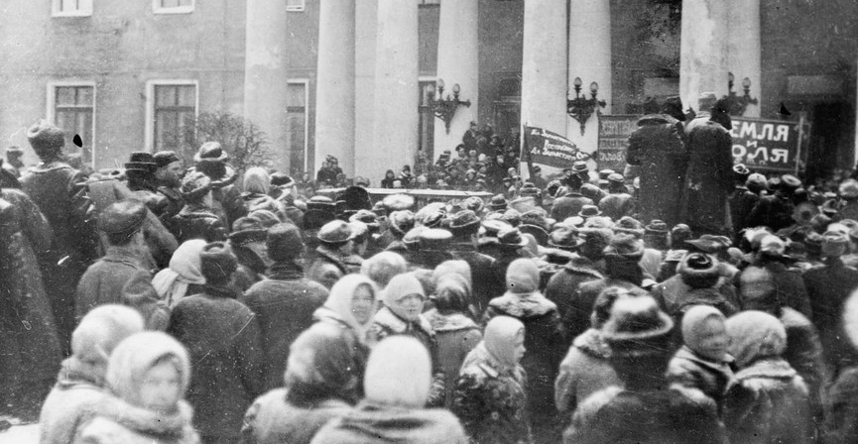
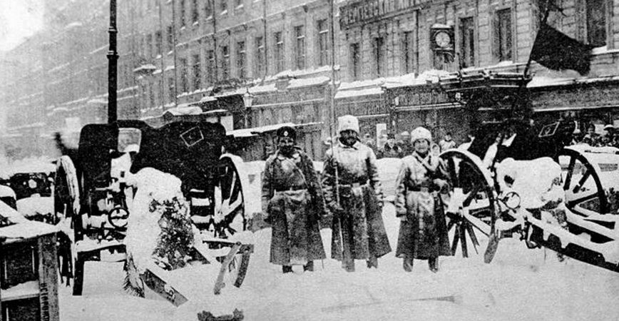
The protests grew in intensity. Workers everywhere in the city went on strike.
The chants of the crowds gradually changed from “BREAD!” to “DOWN WITH THE WAR! DOWN WITH THE TSAR!”
On March 15, Tsar Nicholas II abdicated his throne in favor of his brother, who refused to accept.
The Duma attempted to form a provisional government, but many of the workers and soldiers formed a competing governing council called the Petrograd Soviet.

Slide 19
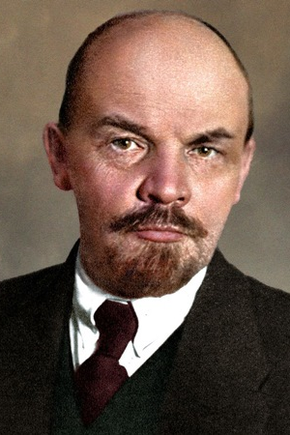
Enter the Revolutionaries
Vladimir Ilych Ulyanov (Lenin)
Born in 1870 in a small town in central Russia
Studied at Kazan University, but was expelled in 1887 for taking part in student protests.
Completed Law studies in 1891
Became radicalized after his older brother was executed for allegedly taking part in a plot to assassinate Tsar Alexander III (Nicholas’s father)
Spent time exiled in Siberia where he married Nadezhda Krupskaya.
He was not involved in the March 1917 revolution. He was in Switzerland writing pamphlets and articles and giving speeches.

Slide 20
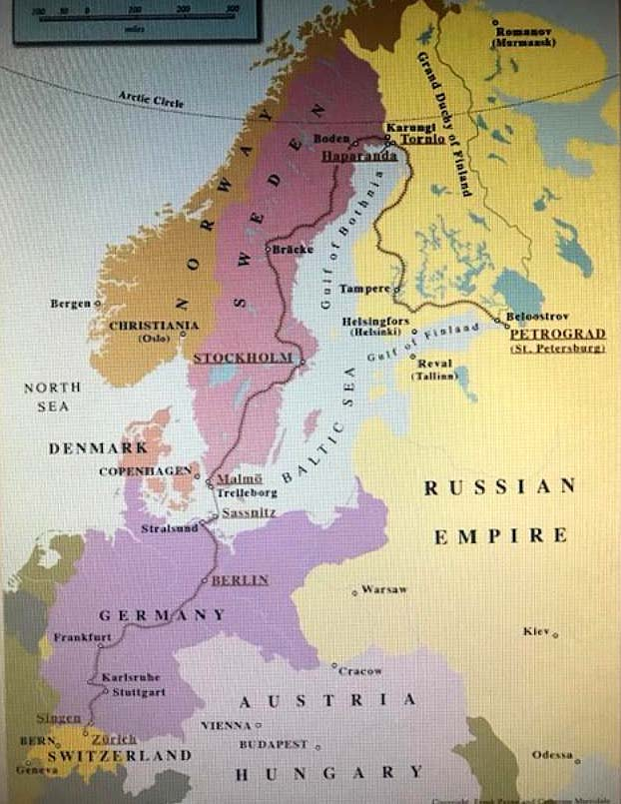
Lenin Returns To Russia
When he learns of the revolution and the abdication of Nicholas, he and about thirty other exiles decide it’s time to get back to Russia and take charge.
Russia was at war with Germany, so how does he get back? The German government not only transported him, but also gave him plenty of cash in order for him to be able to stir up trouble and get Russia out of the war. He arrived in Petrograd on April 16, 1917.
When Kerensky and the people learned that the German enemy was financing him, he had to bug out to Finland until things cooled off.

Slide 21
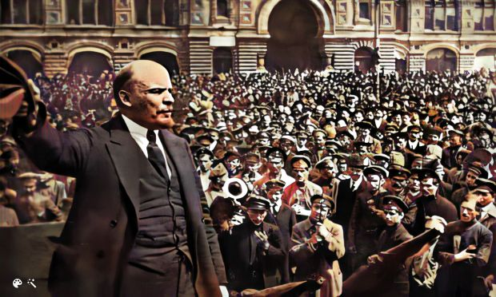
Lenin in Petrograd (St. Petersburg)
Returning from Finland, he is welcomed enthusiastically by the masses. Lenin is a great orator. He gains the support of the masses with the slogan “PEACE, LAND AND BREAD”. He is absolute in his convictions. He is power hungry. He seeks to destroy all vestiges of the Monarchy and upper classes of society with as much violence as possible. As time goes on, anyone that disagrees with him on any matter is a traitor and enemy of the revolution and the people.

Slide 22
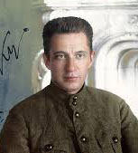
The Provisional Government
The Duma, (House of Representatives) consisted of many members of the old government, They formed a provisional government until a permanent one could be constituted. The provisional government came under the eventual leadership of Alexander Kerensky.
Kerensky advocated supporting the war and Russia’s allies
There were constant conflicts between the Provisionals and the Petrograd Soviet.
Russia continued to fall deeper into chaos. More mass desertions of soldiers and more strikes. When Kerensky ordered more troops to the front, they refused to go. He lost the army, his power base.

Slide 23
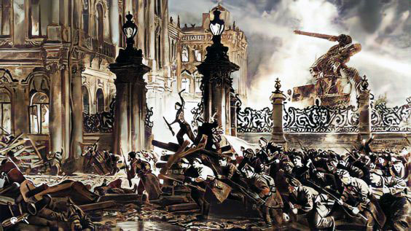
Storming the Winter Palace and taking over
The painting to the right is a highly fictionalized rendering of the taking over of the seat of the provisional government on November 7, 1917 (October 25 on the Russian calendar). The defenders, cadets, Cossacks and women guards quickly surrendered. The Bolsheviks moved to an unlocked room where the Duma was meeting and arrested them. Kerensky had escaped earlier to Finland.

Slide 24
Civil War!
Shortly after the Bolshevik takeover in November 1917, Lenin his comrades allowed a national election that had been previously scheduled by the Provisional Government to take place, believing that the election would legitimize themselves.
The Bolsheviks lost badly. So Lenin decided to impose the “Dictatorship of the Proletariat” Civil war breaks out.
Lenin created the “Red Terror” campaign. Using his newly created secret police, the “Cheka”. He had tens of thousands of his political opponents killed. Many more were exiled to Siberia.
The civil war was fought essentially between the Bolsheviks (Reds) and the Mensheviks (Whites). The Whites consisted of everyone else who were against the Bolsheviks - monarchists, capitalists, supporters of social democracy, etc. in a loose and shifting confederation.
Many Western countries, including the United States sent troops so support the Whites.
The U.S, sent about 5,000 troops called the “Polar Bear Brigade”
The civil war was a mess! No real organized fronts, battles everywhere. Civilian slaughter was rampant. Estimated 10,500,000 killed of which 6,000,000 were civilians.

Slide 25
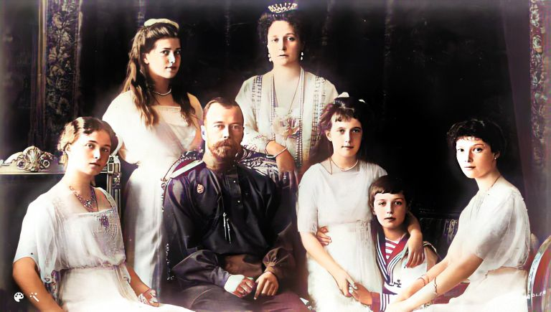
Tsar Nicholas Romanov and his Family

Slide 26
The death of the Romanovs
The Imperial family, Nicholas and Alexandra and their five children: Olga, Tatiana, Maria Anastasia and Alexei were held in various locations by Lenin and the Bolsheviks, and finally transported to the town of Yekaterinburg in the Urals.
The White army was threatening to capture Yekaterinburg, and the decision was made and approved by Lenin to dispose of all of the Romanovs.
On the night of 16–17 July 1918, the family was ordered to a small basement in the Ipatiev house, ostensibly for photographs. They and four retainers were brutally murdered under a hail of bullets by about half a dozen Bolshevik guards.
Their guards were not very good shots, and some of the royal family had to be bayonetted and bashed with rifle butts to finish them off.
Their bodies were taken to the forest, mutilated and scattered and buried.

Slide 27
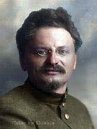
The Civil war drags on
Lev Davidovich Bronstein - better known as Leon Trotsky.
Trotsky was Lenin’s right-hand man.
Joined with Lenin shortly before the October revolution
Negotiated the Brest-Litovsk treaty with Germany to get Russia out of WWI.
Trotsky was brilliant; a military genius and a natural leader. He led the Red Army during the years of the civil war. He excelled in his ability with organization, logistics, strategy, and military tactics.
Many historians believe that without him, the Bolsheviks could not have won the war, and world history would have been radically different.

Slide 28
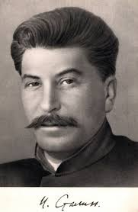
The end of the war, the death of Lenin and the rise of Stalin
The major part of the wartime apocalypse of terror, drought, famine, economic collapse and disease ground slowly to an end in 1921, with pockets of resistance still fighting into 1923.
Loseb Besarionis dzе Jughashvili, ((იოსებ ბესარიონის ძე ჯუღაშვილი) better known as Joe Stalin was not a Russian, but Born in Georgia, then an Imperial colony. He learned Russian as a second language, and always retained an accent.
As a child, he was beaten regularly by both his cobbler father and his mother. A withered arm, a limp from an accident and smallpox scars also helped define his personality.
He became a ruthless thug and enforcer before and during the revolution.
He hated Trotsky because Trotsky was all that he wasn’t: Brilliant, well-spoken, and urbane. But Stalin was more of an in-fighter and became General Secretary of the party.

Slide 29
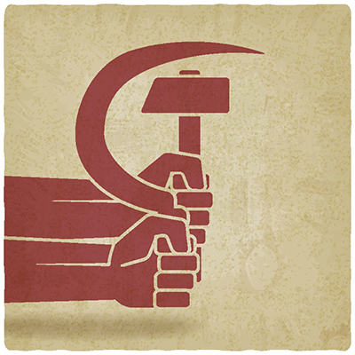
PART 3 – THE LEGACY

Slide 30
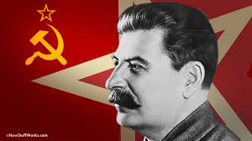
Stalin consolidates power
As General Secretary, Stalin controlled appointments of key government officials, and only appointed those who were completely loyal to him.
By the time Lenin realized that Stalin had gained control, it was too late.
Stalin killed off all of the “Old Guard” party members, including every pall bearer at Lenin’s funeral.
800,000 political executions
1,200,000 die in the Gulags
Agricultural collectivization resulted in famine in Ukraine and the Kazakhs. There were between 4.6 million and 7.5 million deaths by starvation
Many more died in other forced labor projects, including the Moscow subway system and Moscow canals.

Slide 31
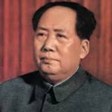
Mao Zedong
1957 - China’s “Great Leap Forward” Radical policies for rapid growth results in the largest famine in world history. 30-35 million deaths. Some historians report 77 million deaths.
1966 – 1976 “Cultural Revolution” Government violence against real or imagined enemies. “Red Guards” were free to execute whomever they wish. 2 to 3 million deaths, plus another 1 million during other campaigns.

Slide 32
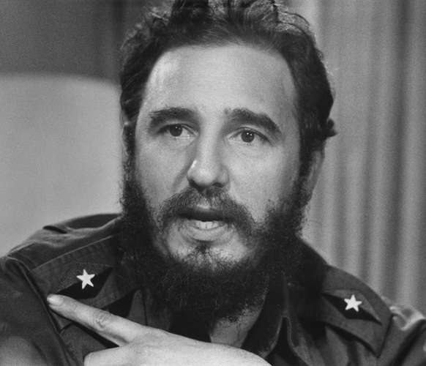
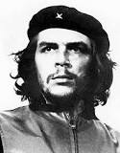
Fidel Castro and Ernesto “Che” Guevara
After ousting the Cuban government of Fulgencio Batista, Castro adopted Leninist philosophy, and converted Cuba into a one-party state under Communist Party rule, the first in the Western Hemisphere. Policies introducing central economic planning, accompanied by state control of the press and the suppression of internal dissent. Abroad, Castro supported anti-imperialist revolutionary groups, backing the establishment of Marxist governments in Chile, Nicaragua, and Grenada, as well as sending troops to aid allies in the Yom Kippur, Ogaden, and Angolan Civil War.
Guevara was an Argentine revolutionary leader who joined with Castro. He rose to second in command and played a pivotal role in the two-year guerrilla campaign that deposed the Batista. He later dedicated himself to spreading Marxist-Leninist revolution throughout South America

Slide 33
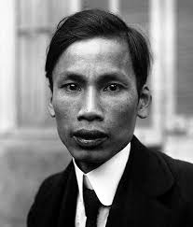
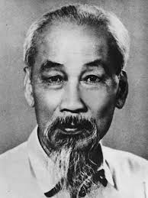
Ho Chi Minh
As a student in Paris in the early 1900’s Ho Chi Minh was working as a waiter in a hotel ballroom while Vladimir Lenin was speaking his doctrine. This greatly influenced his thinking throughout his life.
As the man responsible for the spread of communism in Vietnam, Cambodia and Laos, Ho Chi Minh is directly and indirectly responsible for the lives of 1.7 million Cambodians, 2 million Vietnamese and possibly 230,000 in Laos. These were not war dead, but people murdered, starved to death and “reeducated” to death

Slide 34
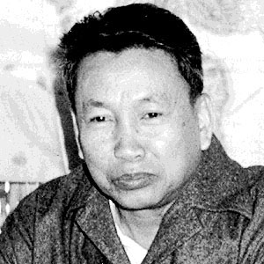
Pol Pot
Pol Pot was a political leader whose communist Khmer Ron 1960 Pol Pot helped to reorganize the KPRP into a party that specifically espoused Marxism-Leninism. His Khmer Rouge government controlled Cambodia from 1975 to 1979. During that time, an estimated 1.5 to 2 million Cambodians died of starvation, execution, disease or overwork. One detention center, S-21, was so notorious that only seven of the roughly 20,000 people imprisoned there are known to have survived. The Khmer Rouge, in their attempt to socially engineer a classless communist society, took particular aim at intellectuals, city residents, ethnic Vietnamese, civil servants and religious leaders. Some historians regard the Pol Pot regime as one of the most barbaric and murderous in recent history.

Slide 35
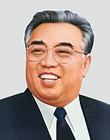
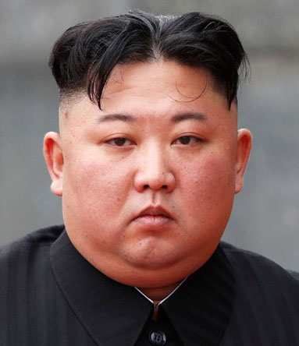
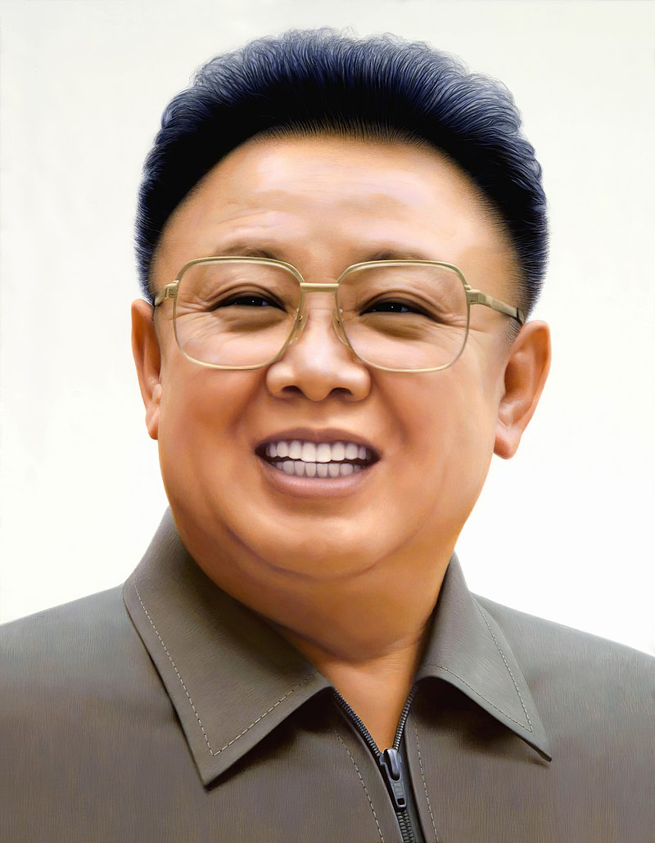
The Kim Dynasty
Leaders of one of the most repressive communist regimes in the world
Kim IL Sung – Took over after defeat of Japan.
Initiated the Korean War by invading South Korea
Kim Jong IL – Really developed the Kim cult. Made a deal with Pres. Clinton to halt nuclear development but later reneged.
Kim Jong Un – You know this guy. Trades insults and hooks up summit meeting with Trump.
Really big in nuclear development and missiles. Big into Cyber warfare, computer viruses and hacking. Kills lots of rivals. Loves sabre rattling.

Slide 36
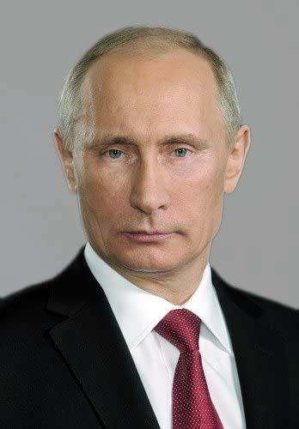
Vladimir Vladimirovich Putin
Putin embraces the aggressive posture of his Soviet predecessors—the murder of oppositionists, the expansion of the state’s territorial boundaries by coercion and violence. in that sense, he is heir to Lenin’s brutal legacy. However, Lenin represented a tumultuous force that turned a society upside down. Lenin was not the kind of figure that Putin, a deeply conservative autocrat, wants to celebrate.
Today, Russia is a “total surveillance state” using a system called “Sorma”. They can take information from all their sources and integrate it with their camera surveillance system. They can use this system to track an individual’s every movement.

